Slide 1
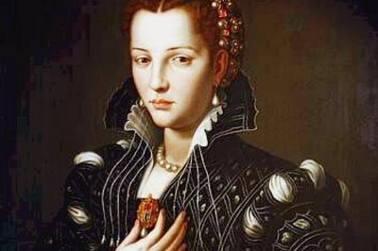
Starter: Remind yourself of the poem and your notes for Ozymandias and My Last Duchess

Slide 2
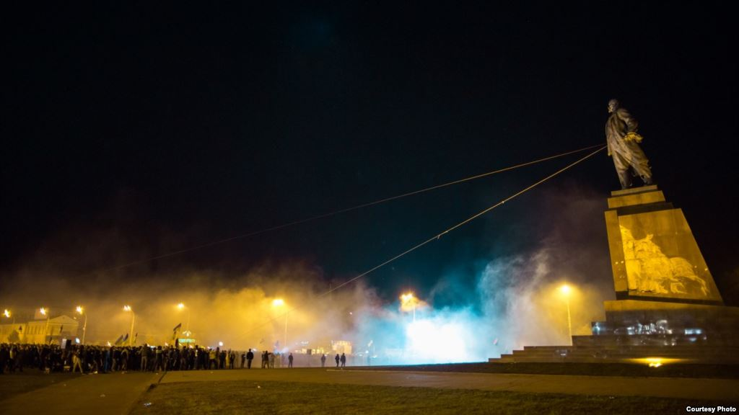
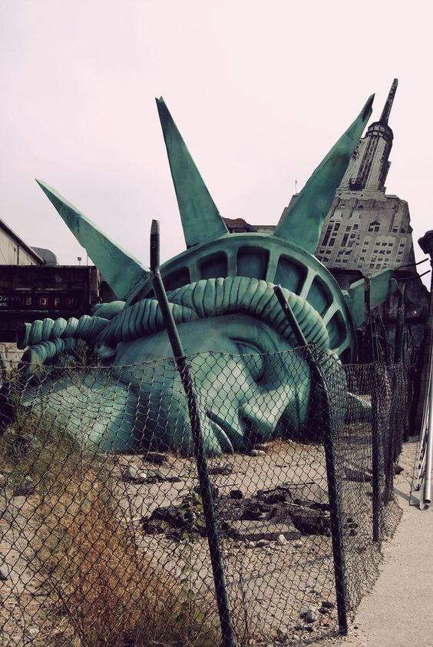
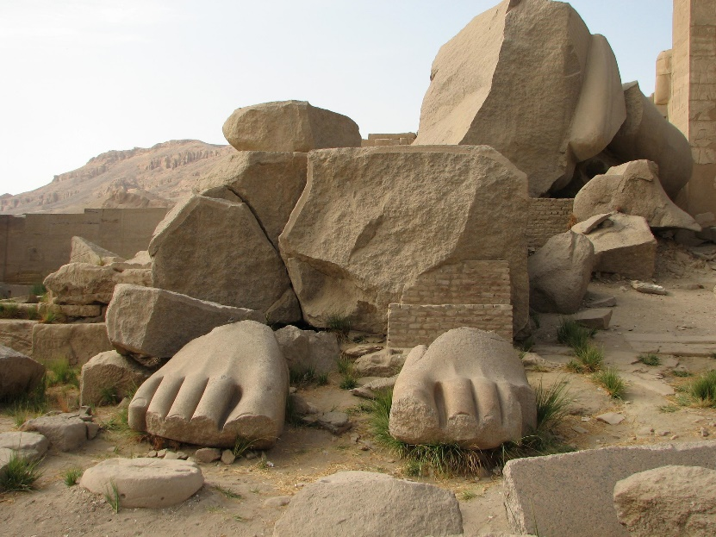
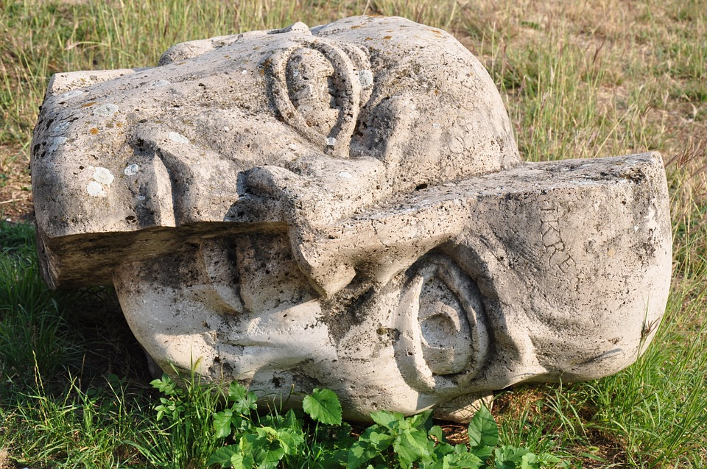
What do these images make you think?

Slide 3

Assessment Objectives
AO1: Read, understand and respond to texts. Students should be able to: maintain a critical style and develop an informed person response; use textual references, including quotations, to support and illustrate interpretations.
AO2: Analyse the language, form and structure used by a writer to create meanings and effects, using relevant subject terminology where appropriate.
AO3: Show understanding of the relationships between texts and the contexts in which they were written.
AO4: Use a range of vocabulary and sentence structures for clarity, purpose and effect, with accurate spelling and punctuation.
Notes:
Resource 1. Additional help for this task can be found on p. 6 & 7 in the poetry student book.

Slide 4
Date: 1818
Power
Title: Ozymandias
Poet: Percy Bysshe Shelley
Main Idea/ Theme:
Authority and power don’t last forever.
Art outlasts powerful men.
Language:
Consonance
Sibilance
Adjectives
Imperative verbs
Metaphor
Caesura
Juxtaposition
Imagery:
Contrast between inscription and the broken statue
Context:
Written by Shelley who was a Romantic poet who died before his 30th birthday. He was known for being a radical who disagreed with the government.
Tone: detached and distant
Rhythm/ Rhyme: Broken for effect (instead of a standard Petrarchan sonnet rhyme scheme)

Slide 5
Ozymandias
Decide which of these summaries you agree with (or come up with your own)
A)
This poem is about the nature of power and authority. The wrecked statue in the lonely desert shows that power only lasts for a time and then is gone.
B)
The poem is about the fact that art truly has power (unlike Ozymandias). The sculptor’s work and the poet’s words are all we know about Ozymandias. Ultimately art is more powerful than kings.

Slide 6
Date: 1842
Power
Title: My Last Duchess
Poet: Robert Browning
Main Idea/ Theme: The power that the duke has over the duchess
Language:
Enjambment
Caesura
Imperative verbs
Rhetorical questions
Ambiguity
Punctuation
Imagery:
People as possessions to be controlled.
Context:
Dramatic monologue based on a story about the Duke of Ferrara and the death of his young wife. Presented as the duke taking a servant on a tour of his house.
Tone: Arrogant and proud
Rhythm/ Rhyme:
Rhymed iambic couplets

Slide 7
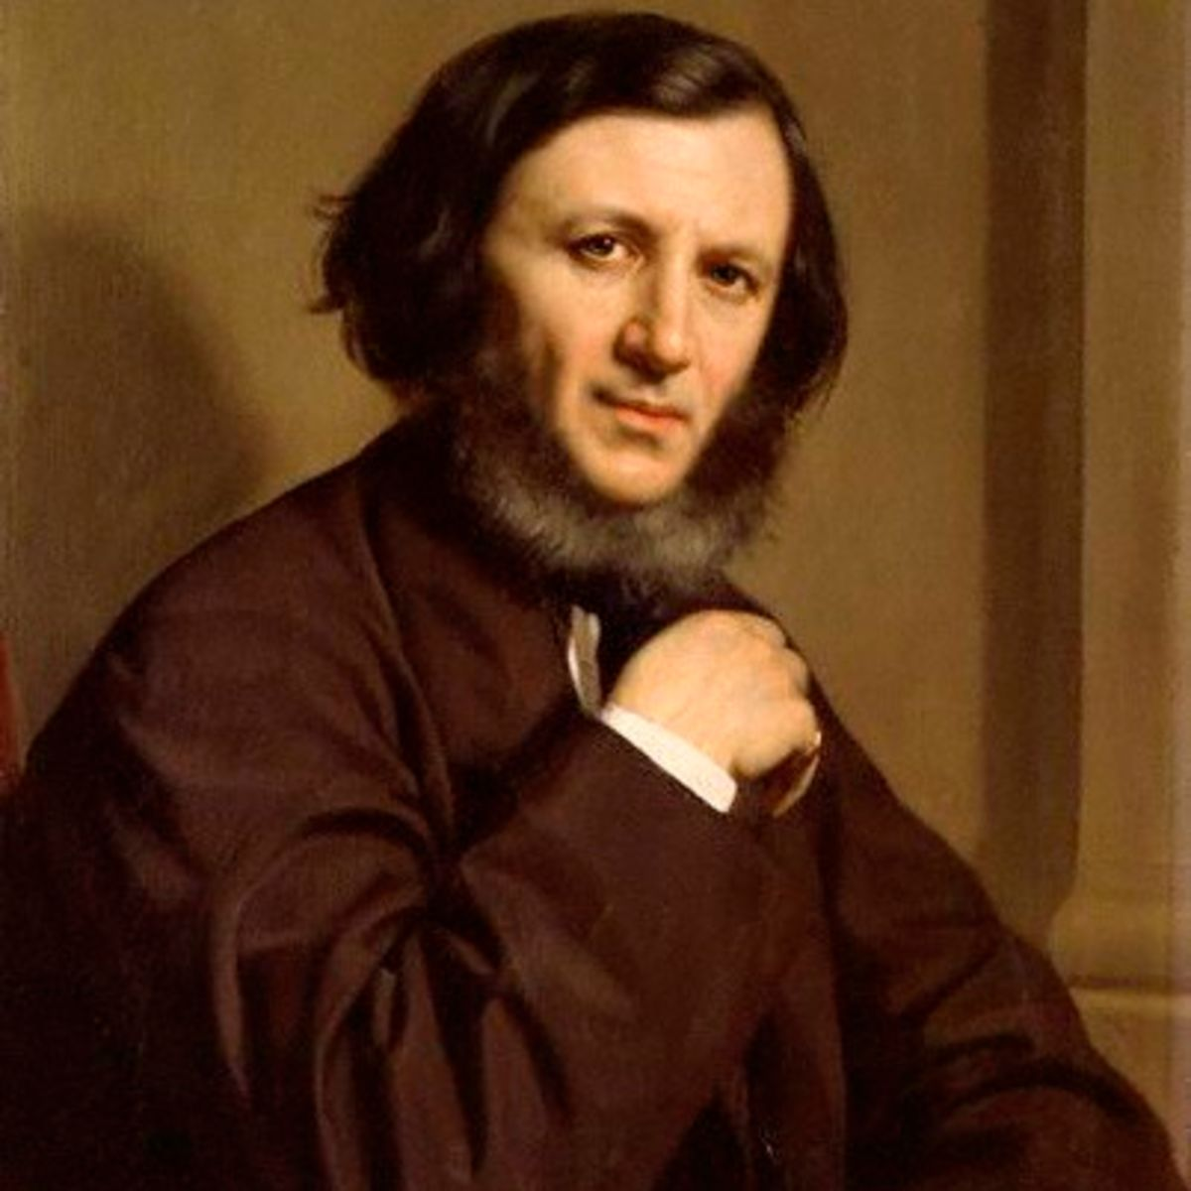
Robert Browing
English poet and playwright
Classed as a Victorian poet
Known for his historical settings
Married Elizabeth Barrett Browning in1846 (who was a better known poet than him!)

Slide 8
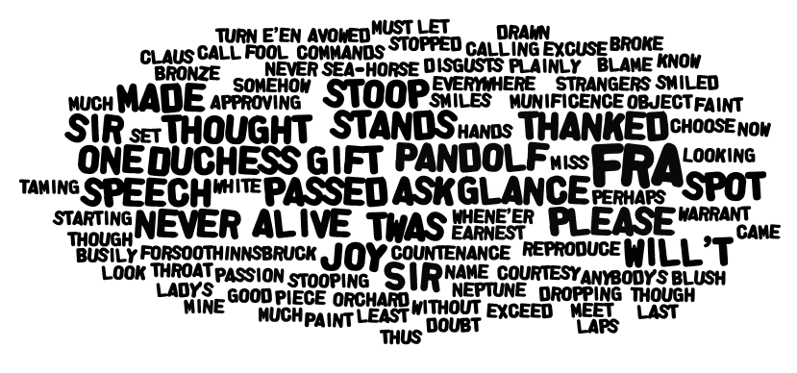

Slide 9
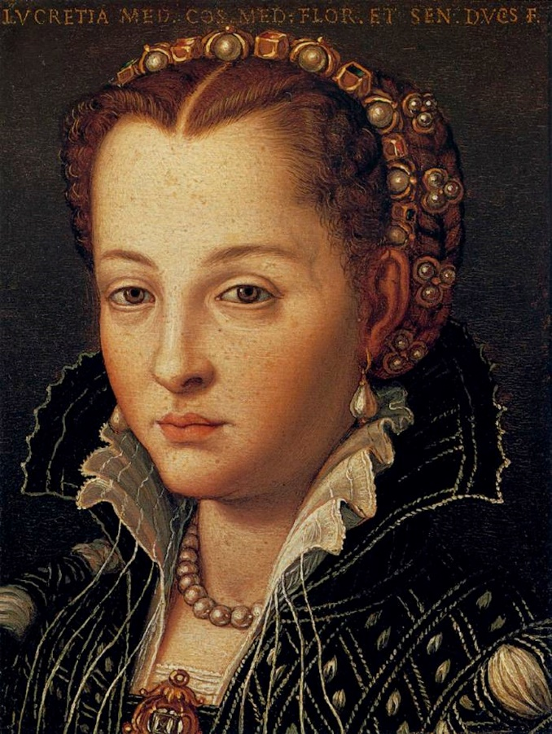
Historical Context
Whilst there are very few biographical details in the poem the word ‘Ferrara’ underneath the title is enough to let the reader know what event is being referred to in the poem.
Duke Alfonso II of Ferrara was suspected of killing his wife in 1561. Lucrezia de Medici was 14 when she married the duke and 17 when she died in suspicious circumstances. The Duke later went on to court and marry the niece of the count of Tyrol.
A03: Text – context relationship

Slide 10

Form
How does the form of the poem make the line “Even had you the skill in speech – (which I have not) – to make your will quite clear to such a one…” ironic?

Slide 11
Comparing the poems
Feature/ technique | Ozymandias (Shelley) | My Last Duchess (Browning)
Powerful male character | Ozymandias dominated the lands around him in lifetime but over time his influence has gone. Evidence? | The Duke holds the power of life and death over his wife and treats her like a possession rather than a person. Evidence?
Language of power | Exclamations/ declarative sentences used. | Phrases commands as questions to give the illusion of choice/ impression of politeness.

